Slide 1
Final Case Study Guide
Telecom Churn Data Set

Slide 2
Agenda
Understanding Data: Creating a data quality report
Variable Profiling: Continuous Variables
Variable Profiling: Categorical Variables
Data preparation: Binning, missing value imputation, derived variables and dummy variable creation
Model Building: Using step wise to select variable
Final model
Creating customer segments
Additional notes

Slide 3
Understanding data: Creating data quality report
A data quality report with the format given below, needs to be created. Refer to the class recordings of “Data preparation and exploration” for approach and R codes
F:\Work\Jigsaw Academy\Data Scientist Course\Data Science Redo\Telecom Case study\Sample Data quality report.xlsx
Variables with a lot of missing values will be omitted from the analysis

Slide 4
Variable Profiling: Continuous Variables
Decile binning should be used to find out event rate (churn rate in this case). If there is a trend (increase in event rate or decrease in event rate), then that variable should be selected for model iterations
For some variables it won’t be possible to do decile binning, one should either divide the data into 8,6,4,3 or 2 equal parts and then look at the event rates. If there is a pattern then, the variable should be chosen for model iterations
Profiling will also aid in data preparation as deciles with similar event rates can be clubbed together into one group and a categorical variable can be created

Slide 5
Variable Profiling: Continuous Variables
Following is an R code sample that can be used to do decile binning. One can refer to pre class video in “Data preparation” for more details on the ntile() function used below:
telecom_data%>%mutate(dec=ntile(totrev,n=10))%>%count(churn,dec)%>%filter(churn==1)->dat45
dat45$N<-telecom_data%>%mutate(dec=ntile(totrev,n=10))%>%count(dec)%>%unname())[[2]]
dat45$churn_perc<-dat45$n/dat45$N
dat45$GreaterThan<-unclass(telecom_data%>%mutate(dec=ntile(totrev,n=10))%>%group_by(dec)%>%summarise(min(totrev)))[[2]]
dat45$LessThan<-unclass(telecom_data%>%mutate(dec=ntile(totrev,n=10))%>%group_by(dec)%>%summarise(max(totrev)))[[2]]
dat45$varname<-rep("totrev",nrow(dat45))

Slide 6
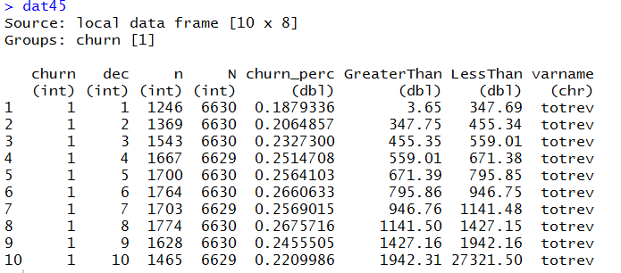
Variable Profiling: Continuous Variables
The code in the previous slide will produce an output like this:
All such objects containing profiles of the continuous variables can be written out as a csv file for further analysis

Slide 7
Variable Profiling: Categorical Variables
Event rate for each level in a categorical variable can be computed
Ideally there should be good difference between the event rate in each level
If some levels have similar event rate then those labels can be combined in a single group

Slide 8
Variable Profiling: Categorical Variables
This is a sample R code that can be used to create categorical variable profiles:
telecom%>%count(churn,levels=actvsubs)%>%filter(churn==1)->datC1
datC1$N<-unclass(telecom%>%filter(actvsubs%in%datC1$levels)%>%count(actvsubs))[[2]]
datC1$ChurnPerc<-datC1$n/datC1$N
datC1$Var.Name<-rep("actvsubs",nrow(datC1))

Slide 9
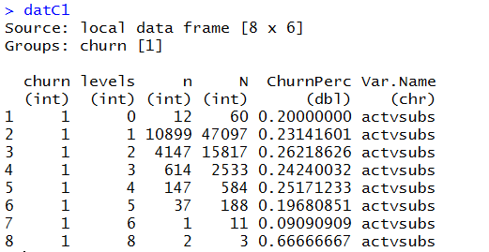
Variable Profiling: Categorical Variables
An output like this will be produced using the code in the previous slide:

Slide 10
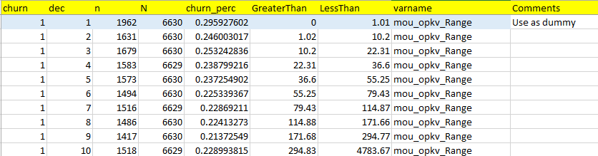
Data Preparation: Continuous Variables
Based on the variable profiles created in the previous steps, data preparation can be done.
Some continuous variables can be converted to dummy variables based on the similarity of event rates.

Slide 11
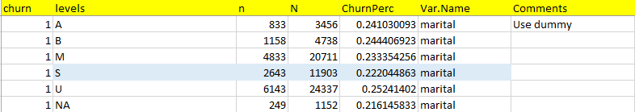
Data Preparation: Categorical Variables
There are categorical variables with several levels, based on the similarity in event rate, these levels can be reduced.
Ideally one should not use a variable with more than 3 levels, if a variable has a lot of levels then they should be reduced.

Slide 12
Data Preparation: Missing Value Imputation
There are several variables with missing values, based on the percentage of missing values in these variables, some variables can be out rightly excluded from analysis
For the variables with a few missing values, imputation can be made by observing the event rate
Here missing values can be imputed as “S”

Slide 13
Data Preparation: Derived Variables
To answer some of the issues raised in the case, additional variables will need to be created for example to understand if “Network issues are leading to churn” following variable can be created
Completion_Percentage=Completed Voice Calls/Total Placed Calls
There are several such issues which have been raised in the case study for which new variables will have to be created.

Slide 14
Model Building: Using stepwise regression
Split the data into test and training sets
Make sure this split is random
If results are to be reproducible then set.seed() can be used
One can use step() function to do a stepwise regression and choose variables
Even after doing a stepwise regression, one would need to run several iterations before the model is finalised

Slide 15
Final Model
The Final model should:
Include variables with significant beta coefficients
Have variables where beta coefficients have a proper sign
Have a good fit measured by AUC or Concordance (For this data an AUC of 0.63-0.62 is attainable)

Slide 16
Creating customer segments
Once the model has been finalized, one of the tasks would be to create customer segments for proactive targeting.
Using the logistic model, one can easily compute the probability of a customer churning and come up with a grid like this:
Probability of Churn (Score)/Revenue | Low (Y1-Y2) | Medium (Y2-Y3) | High (Y3-Y4)
Low (X1-X2)
Medium (X2-X3) |  |  | Target
High(X3-X4) |  | Target | Target

Slide 17
Additional Notes
Make sure you answer the top line questions raised in the case study
A lot of time will have to be spent on exploration/profiling and preparation of data
Before attempting the final case study make sure you have completed all the previous case studies and quiz
Budget sufficient time for submitting the case study and seeking query, last minute submissions and queries can’t be prioritised and will lead to delays.
Make sure final case study submission happens at least 20 days prior to your course expiry.

